Slide 1
Ch5: Using Predicate Logic
Q Representing simple facts in Logic
Q Representing Instance and Isa relationships
Q Make an exception
Q Computable functions and predicates
Q Resolution
Q Natural deduction
Slide <number>

Slide 2
Ch5: Using Predicate Logic
Logic
Logic is concerned with the truth of statements about the world. Generally each statement is either TRUE or FALSE.
Logic includes :Syntax , Semantics and Inference Procedure.
◊ Syntax :
Specifies the symbols in the language about how they can be combined to form sentences. The facts about the world are represented as sentences in logic.
◊ Semantic :
Specifies how to assign a truth value to a sentence based on its
meaning in the world. It Specifies what facts a sentence refers to. A fact is a claim about the world, and it may be TRUE or FALSE.
◊ Inference Procedure :
Specifies methods for computing new sentences from the existing sentences.
Slide <number>

Slide 3
Representing Simple Facts in Logic
Q Using propositional logic
Real-world facts are represented as logical propositions written as well-formed formulas (wff’s)
Example 1:
It is raining | RAINING
It is sunny | SUNNY
It is Windy | WINDY
If it is raining, then it is not sunny | RAINING → ¬SUNNY
Slide <number>

Slide 4
Representing Simple Facts in Logic
– Example 2:
Socrates is a man | SOCRATESMAN
Plato is a man | PLATOMAN
All men are mortal | MORTALMAN
=> Since the assertions are separate, it is not possible to draw any conclusion about similarities between Socrates and Plato.
Slide <number>

Slide 5
Representing Simple Facts in Logic
It would be much better to represent these facts as
Socrates is a man | man(socrates)
Plato is a man | man(plato)
All men are mortal | mortalman
This fails to capture the relationship between any individual being a man and that individual being a mortal.
Therefore it is necessary to move to first order predicate logic as a way of representing knowledge because it permits representation of things that cannot reasonably be represented in prepositional logic.
In predicate logic, real world facts are represented as statements written as wff’s.
Slide <number>

Slide 6
Representing Simple Facts in Logic
Q Propositional logic vs. predicate logic
Using propositional logic
  Theorem proving is decidable
  Cannot represent objects and quantification
Using predicate logic
  Can represent objects and quantification
  Theorem proving is semi-decidable
Slide <number>

Slide 7
Representing Simple Facts in Logic
Consider the following set of sentences.
Marcus was a man.
Marcus was a Pompeian.
All Pompeians were Romans.
Caesar was a ruler.
All Romans were either loyal to Caesar or hated him.
Every one is loyal to someone.
People only try to assassinate rulers they are not loyal to.
Marcus tried to assassinate Caesar
Slide <number>

Slide 8
Representing Simple Facts in Logic
Marcus was a man. man(Marcus)
Marcus was a Pompeian. Pompeian(Marcus)
All Pompeians were Romans.
∀x: Pompeian(x) → Roman(x)
Caesar was a ruler. ruler(Caesar)
Slide <number>

Slide 9
Representing Simple Facts in Logic
5. All Romans were either loyal to Caesar or hated him.
In English the word ‘or’ means the logical inclusive-or and sometimes means the logical exclusive-or(XOR)
inclusive-or
∀x: Roman(x) → loyalto(x, Caesar) ∨ hate(x, Caesar)
exclusive-or (XOR)
∀x: Roman(x) → (loyalto(x, Caesar) ∧ ¬ hate(x, Caesar))
∨ (¬ loyalto(x, Caesar) ∧ hate(x, Caesar))
Slide <number>

Slide 10
Representing Simple Facts in Logic
Every one is loyal to someone.
∀x →y: loyalto(x, y)
People only try to assassinate rulers they are not loyal to.
∀x: ∀y: person(x) ∧ ruler(y) ∧ tryassassinate(x, y)
→ ¬loyalto(x, y)
Marcus tried to assassinate Caesar. tryassassinate(Marcus, Caesar)
Slide <number>

Slide 11
Representing Simple Facts in Logic
To answer the question
Was Marcus loyal to Caesar?
To produce a formal proof , reasoning backward from the desired goal
To prove the goal, rules of inference are to be used to transform into another goal that in turn be transformed and so on, until there are no insatisfied goals remaining.
¬loyalto(Marcus, Caesar)
Slide <number>

Slide 12
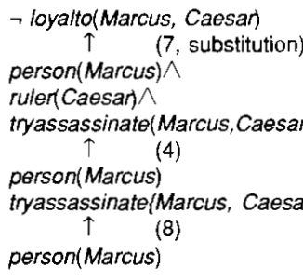
Representing Simple Facts in Logic
This attempt fails , since there is no way to satisfy the goal person(Marcus)with the statements available.
The problem is although its known that Marcus was a man there is no way to conclude it.
Therefore another representation is added namely
Slide <number>

Slide 13
Representing Simple Facts in Logic
9.All men are people
∀x:man(x)→person(x)
This satisfies the last goal and produce a proof that Marcus was not loyal to ceasar.
Three important issues to be addressed in this process of converting English sentences to logical statements and then using these statements to deduce new ones.
Many English sentences are ambiguous. Choosing the correct interpretation may be difficult.
There is often a choice of how to represent knowledge
Obvious information may be necessary for reasoning
We may not know in advance which statements to
deduce (P or ¬P).
Slide <number>

Slide 14
Representing Instance & Isa Relationships
Attributes “ IsA ” and “ Instance ” support property inheritance and play important role in knowledge representation.The ways these two attributes "instance" and "isa", are logically expressed are shown in the example below :
Example : A simple sentence like "Joe is a musician"
Here "is a" (called IsA) is a way of expressing what logically is called a class-instance relationship between the subjects represented by the terms "Joe" and "musician".
◊ "Joe" is an instance of the class of things called "musician". "Joe" plays the role of instance,
"musician" plays the role of class in that sentence.
◊ Note : In such a sentence, while for a human there is no confusion, but for computers each relationship have to be defined explicitly.
This is specified as: [Joe] IsA [Musician]
i.e., [Instance] IsA [Class]
Slide <number>

Slide 15
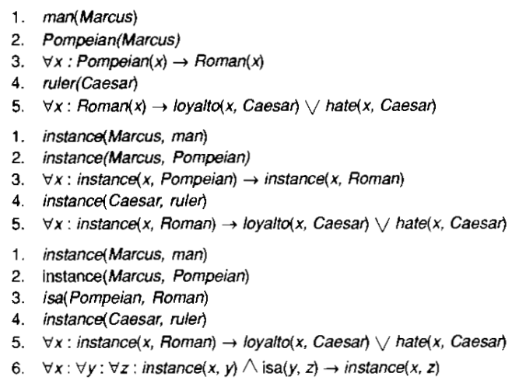
Representing Instance & Isa Relationships
Slide <number>

Slide 16
Representing Instance & Isa Relationships
The first part of the figure contains the representations, in which the class membership is represented with unary predicates, each corresponding to a class. Asserting that p(x) is true is equivalent to asserting that X is an instance of p.
The second part uses the instance predicate explicitly. It is a binary one, whose first argument is an object and whose second argument is a class to which the object belongs. The implication rule in statement 3 states that object is an instance of the subclass pompeian then it is an instance of the superclass Roman.
The third part contains representations that use both the instance and isa predicates explicitly. Use of isa simplifies the representation of sentence 3 but requires one additional axiom.It describes how an instance relation and an isa relation combined to derive a new instance relation.
Slide <number>

Slide 17
Computable Functions and Predicates
All the simple facts can be expressed as combination of individual predicates such as
tryassassinate(Marcus, Caesar)
This is fine if the number of facts is not very large. But suppose if we want to express simple facts such as greater-than and less-than relationships:
Q Computable predicates greater-than(1, 0)
greater-than(2, 1)
greater-than(3, 2)
….
less-than(0, 1)
less-than(1, 2)
less-than(2, 3)
….
Slide <number>

Slide 18
Computable Functions and Predicates
It is not possible to write out the representation of each of these facts individually as they are infinitely many of them.
But if only the finite number of them are to be represented, it would be extremely inefficient to store explicitly a large set of statements instead so easily compute each one as we need it.
Thus it becomes useful to argument the representations by computable predicates.
A procedure will be invoked which is specified in addition to the regular rules, that will evaluate it and return true or false.
It is often useful to have computable functions as well as computable predicates.
Eg:gt(2+3,1), the value of the plus function is computed given the arguments 2 and 3 , and then send the arguments 5 and 1 to gt
Slide <number>

Slide 19
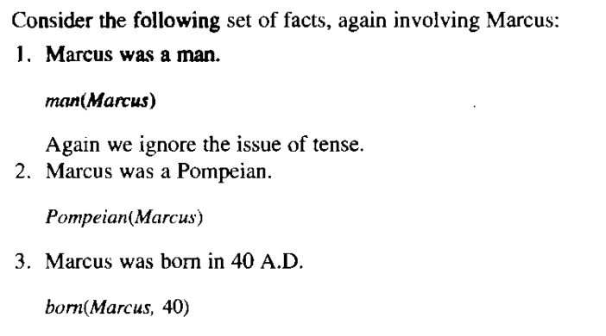
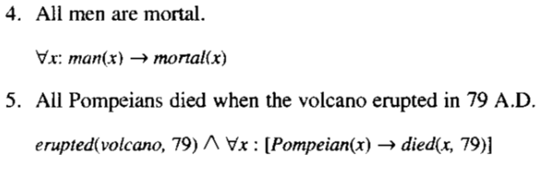
Computable Functions and Predicates
Slide <number>

Slide 20
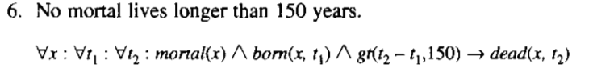



Computable Functions and Predicates
Slide <number>

Slide 21
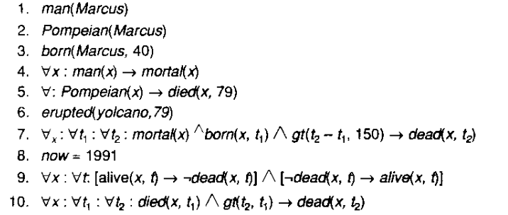
Computable Functions and Predicates
Set of facts about Marcus
The numbering is changed slightly because sentence 5 has been split into two parts.
Slide <number>

Slide 22
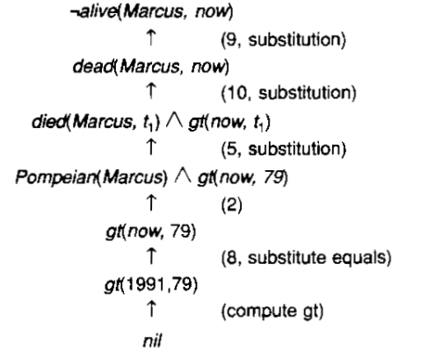
Computable Functions and Predicates
The question is “Is Marcus alive?” This question can be answered by proving
¬alive(Marcus,now)
The term nil at the end of each proof indicates that the lsit of conditions remaining to be proved is empty and so the proof has succeeded.
Slide <number>

Slide 23
Resolution
From looking at the proofs, two things are clear.
Even very simple conclusions can require many steps to prove.
A variety of processes such as matching, substitution are involved in the production of a proof.
Resolution
This reduces some of the complexity because it operates on statements that have first been converted to a single canonical form.
Resolution produces proofs by refutation.
In other words to prove a statement(i.e show that it is valid) resolution attempts to show that the negation of the statement produces a contradiction with the known statements.
This approach contrasts with the technique that generate proofs by chaining backward from the theorem to be proved to the axiom.
Slide <number>

Slide 24
Algorithm: Convert to Clause Form
Eliminate →, using: a → b= ¬ a v b.
Reduce the scope of each ¬ to a single term, using:
  ¬ (¬ p) = p
  deMorgan's laws: ¬(a Λ b) = ¬ a V ¬ b
  ¬(a V b) = ¬ a Λ ¬ b
  ¬ ∀x P(x) = ∃x ¬ P(x)
  ¬ ∃x P(x) = ∀x ¬ P(x)
Standardize variables.
Move all quantifiers to the left of the formula without changing their relative order.
Eliminate existential quantifiers by inserting Skolem functions.
Drop the prefix.
Convert the expression into a conjunction of disjuncts, using associativity and distributivity.
Create a separate clause for each conjunct.
Standardize apart the variables in the set of clauses generated in step 8, using the fact that: (∀x: P(x) Λ Q(x)) = ∀x: P(x) Λ ∀x: Q(x)

Slide 25
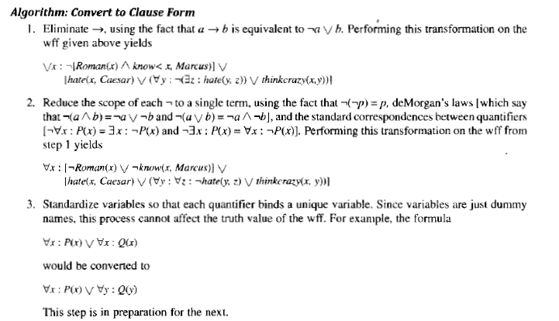
Resolution
Slide <number>

Slide 26
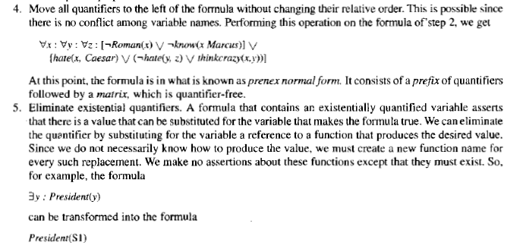
Resolution
Slide <number>

Slide 27
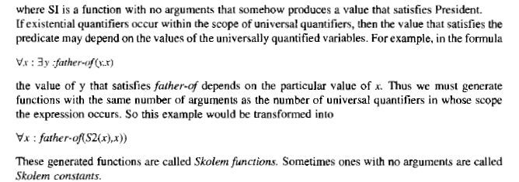
Resolution
Slide <number>

Slide 28
Resolution
Slide <number>

Slide 29
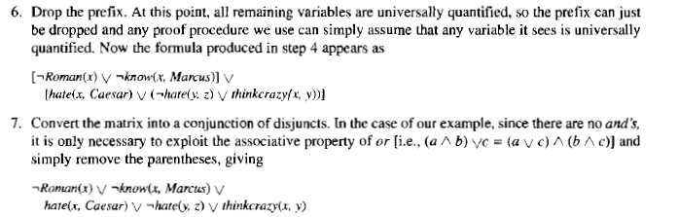
Resolution
Slide <number>

Slide 30
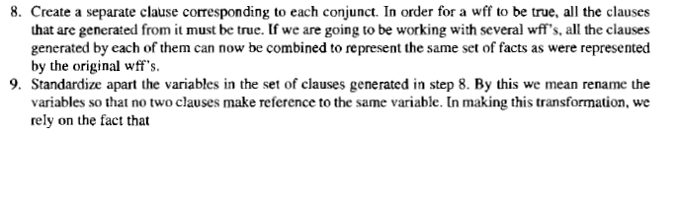
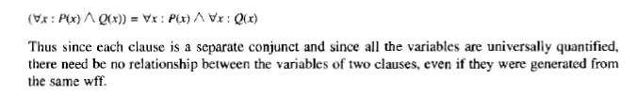
Resolution
Slide <number>

Slide 31
Resolution
After applying this entire procedure to a set of wff’s, a set of clauses will be obtained each of which is a disjunction of literals.
These clauses can now be exploited by the resolution procedure to generate proofs.
Slide <number>

Slide 32
Skolem Functions in FOL
Objective
  Want all variables universally quantified
  Notational variant of FOL w/o existentials
  Retain implicitly full FOL expressiveness
Skolem’s Theorem
Every existentially quantified variable can be replaced by a unique Skolem function whose arguments are all the universally quantified variables on which the existential depends, without changing FOL.
Examples
  “Everybody likes something”
  ∀(x) ∃ (y) [Person(x) & Likes(x,y)]
  ∀(x) [Person(x) & Likes(x, S1(x))]
  Where S1(x) = “that which x likes”
  “Every philosopher writes at least one book”
  ∀(x) ∃(y)[Philosopher(x) & Book(y)) => Write(x,y)]
  ∀(x)[(Philosopher(x) & Book(S2(x))) => Write(x,S2(x))]

Slide 33
The Basis of Resolution
The resolution procedure is a simple iterative process
at each step two clauses called the parent clauses are compared(resolved) yielding a new clause that has been inferred from them.
The new clause represents ways that the two parent clauses interact with each other.
Given:
winter V summer
¬ winter V cold
We can conclude:
summer v cold
Both the clauses must be true. If winter is true, then cold must be true to guarantee the truth of the second clause and vice versa.

Slide 34
The Basis of Resolution
This is the deduction that the resolution procedure will make.
Resolution operates by taking two clauses that each contain the same literal, in this example winter.
The literal must occur in positive form in one clause and in negative form in the other.
The resolvent is obtained by combining all the literals of the two clauses except the ones that cancel.
If the clause that is produced is the empty clause,then a contradiction has been found.Example
  Winter
  ¬Winter
  Will produce the empty clause.

Slide 35
Herbrand's Theorem
Herbrand's Theorem:
To show that a set of clauses S is unsatisfiable, it is necessary to consider only interpretations over a particular set, called the Herbrand universe of S. A set of clauses S is unsatisfiable if and only if a finite subset of ground instances (in which all bound variables have had a value substituted for them) of S is unsatsifable.

Slide 36
Algorithm: Propositional Resolution
Convert all the propositions of F to clause form.
Negate P and convert the result to clause form. Add it to the set of clauses obtained in step 1.
Repeat until either a contradiction is found or no progress can be made:
  a) Select two clauses. Call these the parent clauses.
  b) Resolve them together. The resolvent will be the disjunction of all of the literals of both of the parent clauses with the following exception: If there are any pairs of literals L and ¬ L such that one of the parent clauses contains L and the other contains ¬L, then select one such pair and eliminate both L and ¬L from the resolvent.
  c) If the resolvent is the empty clause, then a contradiction has been found. If it is not, then add it to the set of clauses available to the procedure.

Slide 37
A Few Facts in Propositional Logic
OR is allowed and AND is not allowed.
Implications are also not allowed.
Given Axioms(wff’s) Clause Form(conjuctive normal form)
1.P P (1)
2.(P Λ Q) → R ¬P V ¬Q V R (2)
De Morgan’s Law
1)¬(a Λb)= ¬a V ¬b
2)¬(a V b)= ¬a Λ ¬b
¬ (P Λ Q) V R= ¬P V ¬Q V R

Slide 38
A Few Facts in Propositional Logic
3.(S V T) → Q ¬S V Q (3)
4. ¬T V Q (4)
(S V T) V Q= (¬ S Λ ¬ T) V Q
By Distributive law= (¬ S V Q) Λ(¬ T V Q)
5.T T (5)
To prove R. First the axioms are converted to clause form. Then we negate R.
Then pairs of clauses are selected to resolve together.
Although any pairs of clauses can be resolved, only those pairs that contain complementary literals will produce a resolvent that is likely to lead to the goal of producing the empty clause.

Slide 39
Resolution in Propositional Logic
¬P V ¬Q V R
¬R
¬P V ¬Q
P
¬T V Q
¬Q
¬T
T

Slide 40
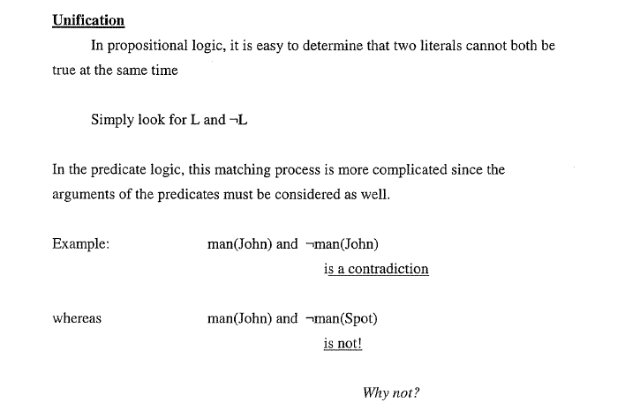
Unification Algorithm

Slide 41
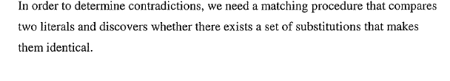
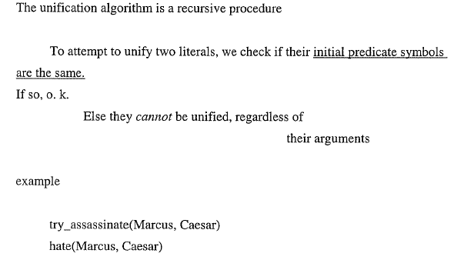
Unification Algorithm

Slide 42
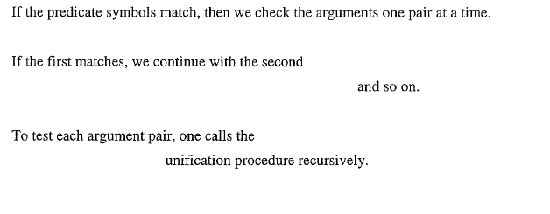
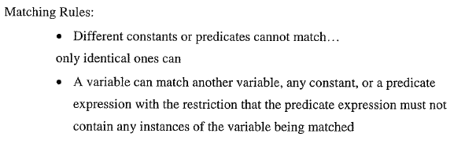
Unification Algorithm

Slide 43
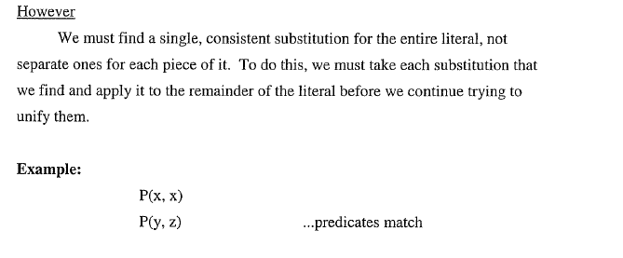
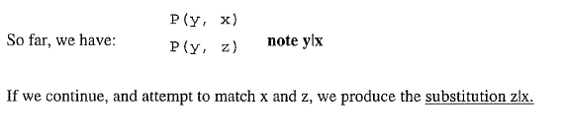
Unification Algorithm

Slide 44
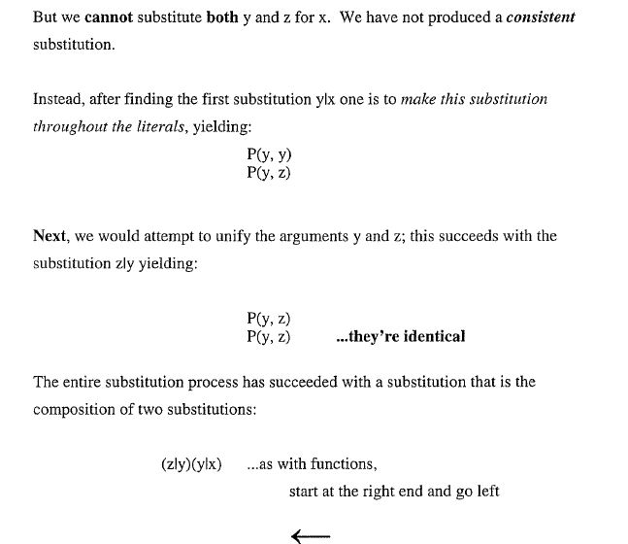
Unification Algorithm

Slide 45
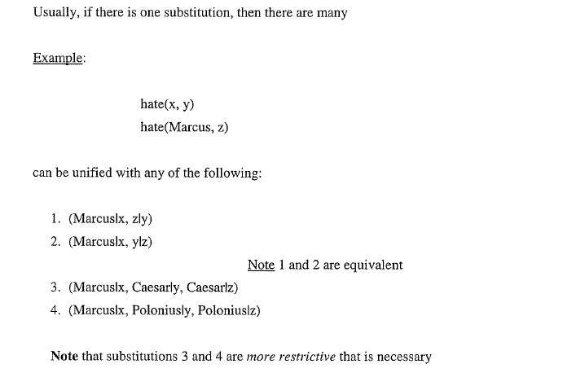

Unification Algorithm

Slide 46
Algorithm: Unify(L1,L2)
1. If L1 or L2 is a variable or constant, then: a) If L1 and L2 are identical, then return NIL. b) Else if L1 is a variable, then if L1 occurs in L2 then return FAIL, else return {(L2/L1)}. c) Else if L2 is a variable, then if L2 occurs in L1 then return FAIL, else return {(L1/L2)}. d) Else return FAIL. 2. If the initial predicate symbols in L1 and L2 are not identical, then return FAIL. 3. If L1 and L2 have a different number of arguments, then return FAIL | 4. Set SUBST to NIL. 5. For i ← 1 to number of arguments in L1: a) Call Unify with the ith argument of L1 and the ith argument of L2, putting result in S. b) If S = FAIL then return FAIL. c) If S is not equal to NIL then: i. Apply S to the remainder of both L1 and L2. ii. SUBST := APPEND(S, SUBST). 6. Return SUBST.

Slide 47
Algorithm: Resolution
Convert all the propositions of F to clause form.
Negate P and convert the result to clause form. Add it to the set of clauses obtained in 1.
Repeat until either a contradiction is found, no progress can be made, or a predetermined amount of effort has been expended.
  a) Select two clauses. Call these the parent clauses.
  b) Resolve them together. The resolvent will be the disjunction of all the literals of both parent clauses with appropriate substitutions performed and with the following exception: If there is one pair of literals T1 and ¬ T2 such that one of the parent clauses contains T1 and the other contains ¬ T2 and if T1 and T2 are unifiable, then neither T1 nor ¬ T2 should appear in the resolvent. If there is more than one pair of complementary literals, only one pair should be omitted from the resolvent.
  c) If the resolvent is the empty clause, then a contradiction has been found. If it is not, then add it to the set of clauses available to the procedure.

Slide 48
A Resolution Proof
Axioms in clause form:
1. man(Marcus)
2. Pompeian(Marcus)
3. ¬ Pompeian(x₁) v Roman(x₁)
4. Ruler(Caesar)
5. ¬ Roman(x₂) v loyalto(x₂, Caesar) v hate(x₂, Caesar)
6. loyalto(x₃, f1(x₃))
7. ¬ man(x₄) v ¬ ruler(y₁) v ¬ tryassassinate(x₄, y₁) v
loyalto (x₄, y₁)
8. tryassassinate(Marcus, Caesar)

Slide 49
Resolution Proof cont.
Prove: hate(Marcus, Caesar)
¬hate(Marcus, Caesar)
5
Marcus/x₂
3
¬Roman(Marcus) V loyalto(Marcus,Caesar)
Marcus/x₁
¬Pompeian(Marcus) V loyalto(Marcus,Caesar)
2
7
loyalto(Marcus,Caesar)
Marcus/x₄, Caesar/y₁
1
¬man(Marcus) V ¬ ruler(Caesar) V ¬ tryassassinate(Marcus, Caesar)
¬ ruler(Caesar) V ¬ tryassassinate(Marcus, Caesar)
4
¬ tryassassinate(Marcus, Caesar)
8

Slide 50
An Unsuccessful Attempt at Resolution
Prove: loyalto(Marcus, Caesar)
¬loyalto(Marcus, Caesar)
5
Marcus/x₂
3
¬Roman(Marcus) V hate(Marcus,Caesar)
Marcus/x₁
¬Pompeian(Marcus) V hate(Marcus,Caesar)
2
hate(Marcus,Caesar)
(a)
hate(Marcus,Caesar)
10
Marcus/x₆, Caesar/y₃
persecute(Caesar, Marcus)
9
Marcus/x₅, Caesar/y₂
hate(Marcus,Caesar)
:
:
(b)

Slide 51
Question Answering
When did Marcus die?
Whom did Marcus hate?
Who tried to assassinate a ruler?
What happen in 79 A.D.?
Did Marcus hate everyone?
Q Answering = finding a known statement that matches the terms given in the question
Slide <number>

Slide 52
Question Answering
Slide <number>

Slide 53
Question Answering
When did Marcus die?
∃ t: died(Marcus, t)
Resolution:
¬ ∃ t: died(Marcus, t) = ¬ died(Marcus, t)
¬ died(Marcus, t) 79 / t, Marcus / x
¬ Pompeian(x) v died(x, 79)
Pompeian(Marcus)
¬ Pompeian(Marcus)
false
Slide <number>

Slide 54
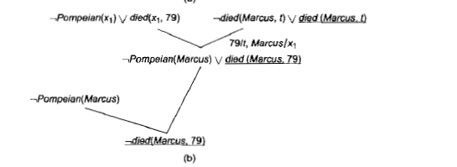
Question Answering
Slide <number>

Slide 55
Natural Deduction
Q Problems with resolution
The heuristic information contained in the original statements can be lost in the transformation
∀x: judge(x) ∧ ¬ crooked(x) → educated(x)
¬ judge(x) v crooked(x) v educated(x)
People do not think in resolution
Q Natural deduction: A way of doing machine theorem proving that corresponds more closely to processes used in human theorem proving
Slide <number>

